Slide 1
State of the Planet
extras

Slide 2

What are extras?
extras are the solution for when there’s just too much exciting information for one presentation!
While fun and exciting, this information will not be on any Design Challenges or exams

Slide 3
How are extra slides organized?
See extra 1
When you see this symbol on an in-class lecture slide, it means that there is additional information on topic “1” found in the extra slides
Each extra slide deck will have a table of contents listing the information it contains
Ctrl+click on a tag ( ) to jump to a section!
Extra 1

Slide 4
State of the Planet
extras
Extra 1
Burden of unsafe water
Intermittent Supplies
Extra 2

Slide 5
1.
Burden of unsafe water

Slide 6
More Honduras Stats
extra
In 2006, only 75% of the drinking water in urban areas was disinfected^{[2]} and 10% of the wastewater that was collected received treatment.^{[3]}
In rural areas, it was estimated that only one-third of the systems provided continual service and less than 14% of the systems delivered disinfected water in 2004 .^{[4]}
http://en.wikipedia.org/wiki/Water_supply_and_sanitation_in_Honduras

Slide 7
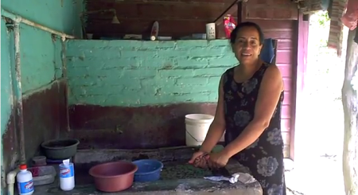
Reina Amador Diaz: Tamara, Honduras
extra
“I used to boil the water for hours and it would still be dirty.” As a cook, Dona Reina saves times by receiving clean water directly into her home. She used to worry about spreading illnesses when she cooked. “Now the water is pure; I know I am serving people healthy, clean food.”
Dona Reina says that the water treatment plant has attracted new residents. “We have cleaner water than the capital!”

Slide 8
2.
Intermittent Supplies

Slide 9
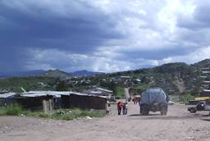
Consequences of Intermittent Supplies
extra
Intermittent water supply is a significant constraint on the availability of water for hygiene
And personal hygiene is very important!!!
Encourages the low-income urban population to turn to alternatives such as water vendors
That are expensive and from dubious sources
Point of Use Storage
That may create risk of contamination
Risks of distribution system contamination
Notes:
http://www.who.int/docstore/water_sanitation_health/Globassessment/Global3.4.htm

Slide 10
Consequences of Intermittent Supplies
extra
Contamination may also occur by intrusion of contaminated water into the pipelines through faulty joints, cracks, etc.
Opportunity for contamination by siphoning
Loss of chlorine residual in stagnant water
The pipelines are subject to additional stress caused by transient flows (water hammer), affecting the durability of the system and weakening pipes and joints (more leaks…)
Water waste increases
Complaints about metering air (if there are meters)

Slide 11
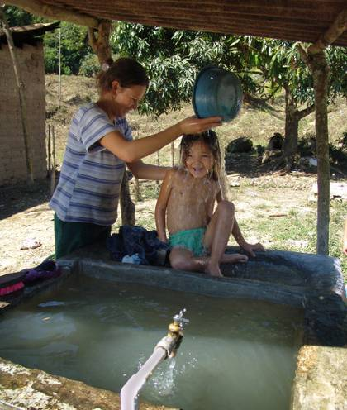
Point of Use (or distributed) Storage
extra
When there is frequent intermittence in the water distribution system, the consumers commonly build or buy domestic storage tanks
Although these devices help to reduce hourly peaks in demand and mask short-term interruptions for users, they are often neither properly protected nor regularly cleaned and disinfected
But they might be a very good idea!
Notes:
http://www.who.int/docstore/water_sanitation_health/Globassessment/Global3.4.htm

Slide 12
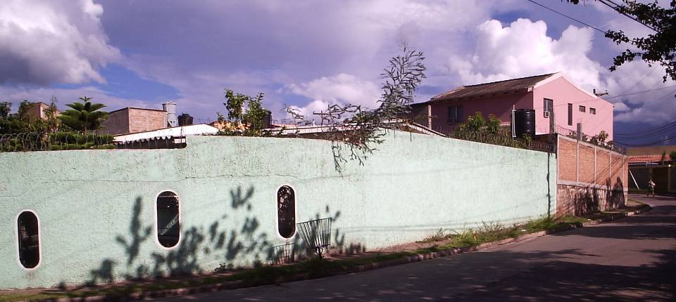
Water Storage Tanks
extra
Photo by Chris Boone

Slide 13
Eliminating Intermittency
extra
Reduce demand – metering
Meters are expensive or (cheaper and unreliable)
Eliminate leaks
Reducing intermittency is a significant engineering and societal challenge
We need engineers and social scientists to work together and come up with techniques to improve distribution system performance when the water supply is limited
Community size may influence the solution

